Slide 1

LO3-Week 7-
Training Needs Analysis & organigram

Slide 2

End
This session has ended. Thank for your attendance and active participation. IT’S ALL ABOUT YOU !

Slide 3
Module lecturer-Tayo Alebiosu
Health and Social Care
Continuous Professional Development
Contact me: tayo.alebiosu@lsclondon.co.uk

Slide 4

Aim;
L03-Negotiate and plan learning, continuing professional development needs.
Learning outcomes
At the end of this lesson students will be able to;
Explore the concept of Training Needs Analysis
Produce an organigram for a learning plan design to meet the need of individuals

Slide 6

Presenting your assignment
Title page-Your student number, the module and submission date
Content page
Introduction
Font –Ariel, Times New Roman
Font size -12
Line spacing – 1.5
Paragraphing-Not too short or too long
Page number
In text referencing
Reference list using Harvard referencing style
Reference list should be in alphabetical order
Proof read for grammar errors
Submit as a single document i.e. a word document or Pdf
Conclusion

Slide 7

Individually, using your internet device
Research the meaning of Training needs analysis
Feedback to the class

Slide 8
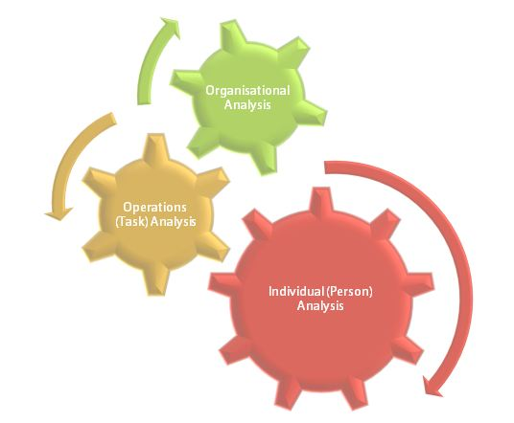
Individually, (5 minutes)
Research the meaning of training needs analysis and its benefits in the healthcare sector
Feedback to the class
https://youtu.be/W7Y_AxYz2No
A Training Needs Assessment or Training Needs Analysis TNA is a systematic process that applies work analysis techniques and procedures to identify and specify training requirements that have been linked to deficiencies in individual, team, or organization performance to develop learning objectives to address the identified deficiencies. This video overviews the key components of a training needs assessment.

Slide 9

What Is Training Needs Analysis?
Training needs analysis is a process that a business goes through in order to determine all the training that needs to be completed in a certain period to allow their team to complete their job as effectively as possible, as well as progress and grow.

Slide 10
Training and Development Needs Analysis Checklist
Your training needs analysis should include the following:
Know what the organization is trying to accomplish.
Know the history of training within the organization.
What "needs" will be addressed by the training?
Any recent process or procedure changes?
What resources are available for training?
Who needs to be trained?
Who can serve as subject matter experts?
Are any staff going to do the training?
Which companies provide training materials?
What are the Knowledge, Skills, and Abilities?
Review Job Descriptions and Org Charts.

Slide 11
What does TNA mean?
To start we will first uncover exactly what is a TNA actually means and can do for a company. TNA stands for Training Needs Analysis or Assessment.
Training Needs Analysis is the process of identifying training needs in an organization for the purpose of improving employee job performance.
A needs analysis involves collecting information to determine if a training need exists and, if so, what kind of training is required to meet this need.
The analysis also should address why the need exists.

Slide 12


Training Needs Analysis- (TNA)
Oftentimes healthcare organisation may face issues with service improvement and the workaround for this would be throwing the entire group into a costly, time interfering and ultimately unorganized training session that does nothing for the company R.O.I. (Return on Investment).
To help solve the daunting task and costly mistake of bad training would be to conduct a well thought out TNA also known as Training Needs Analysis.

Slide 13

TNA can provide many benefits such as identifying any performance gaps with better accuracy.
It can examine any performance gaps that may exist in the organization, between the people and strategies.
It can also allow you to hone in your focus on key areas that need the greatest improvement and training.
It is through an organizational analysis in a TNA that a plan is enacted to better help the organization plan and adapt to anticipated changes and new objectives.
Additionally, TNA can provide other benefits such as improving high performance among the workplace through engagement, participation, analyzing and discovering various ways to improve and development high performance.

Slide 14
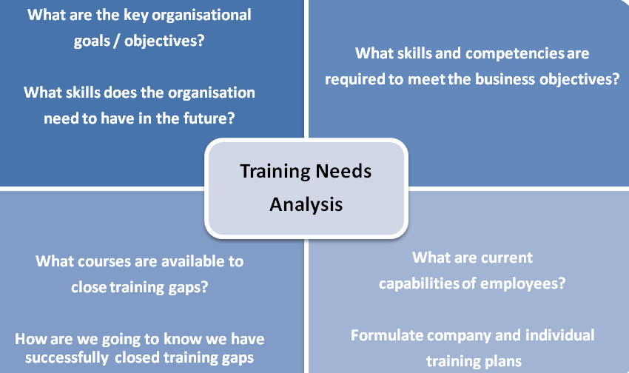

Slide 15

When should a TNA be conducted? The Checklist is an important tool to use to keep things organized through this entire process.
Organization will be key to a successful TNA and pre preparation is better than no prep.

Slide 16
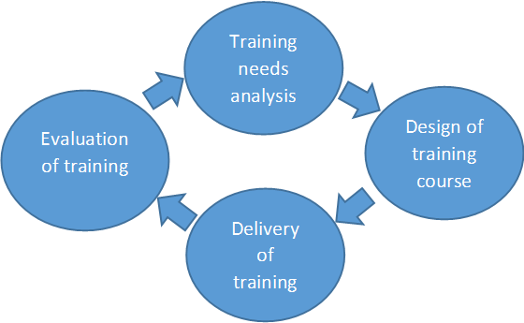
How to identify staff training needs
To identify training that matches the specific needs of your staff and business goals you can carry out a training needs analysis (TNA).
Training needs analysis is a method used by businesses to identify training requirements in a cost efficient way.
This process involves evaluating training needs and weighing up training priority areas at all levels within a business. Training needs analysis forms the first step of the training development cycle:

Slide 17
What are the stages of training needs analysis?
There are three key stages of training needs analysis.
These involve identifying the direction of the organisation, understanding the skills and knowledge of staff through a task analysis, and analysing the individual needs of each employee.
These three stages of training needs analysis are explained in more detail below:

Slide 18
There are 3 key steps involved in training needs analysis to ensure your business is making the most of the process:
Decide On Skill Sets
The first stage is to decide on the skill sets that you require all your team members to have in order to do their jobs properly. This means looking at every job role within your business separately and considering things like the different departments or levels of seniority which will affect this as well.
Evaluate The Skills Of Staff
The second stage is to look at all your team members and evaluate their current skill levels in relation to the skills you have laid out in the first stage of this process. This will allow you to see who is meeting your expectations, and who needs to complete further training in order to meet the expected skill level.
Highlight The Skills Gap
Now that you know where you want your team to be and the level they are currently at, you will easily be able to see the gap (if any) that has appeared between the two. Now you know what the gap is, you need to use training to help close that gap and ensure your team is at the level you expect them to be.

Slide 19
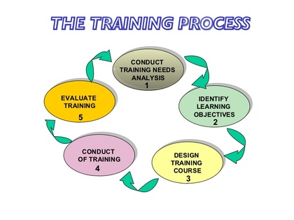

Slide 20
WRAP-UP
Question and Answer Session

Slide 22

Benefits TNA For Your Business
1. Identify Knowledge Gaps Before They Become A Problem
One huge benefit of conducting training needs analysis is the fact it can help you identify any knowledge gaps your employees may have before it becomes an issue.
It’s better to highlight a potential problem and tackle it head-on, rather than becoming aware of the skills gap when an issue arises because of it.
The training needs analysis will allow you to take a proactive approach rather than waiting for something to go wrong before you realise there is a problem.

Slide 23

Benefits of TNA
2. Helps You To Plan Your Training For The Year
Another huge benefit of training needs analysis is that it makes it much easier for you to plan your training for the upcoming year (or whatever block of time you work with).
Once you have identified the skills gaps that exist in your business, and then all the staff members who need additional training in certain areas, it’s easy to pull together a training plan which will cover all these skills gaps.
Rather than trying to guess the type of training that will be most useful to your organisation, or who needs to complete the training, your training needs analysis will make the whole task much easier, and you can be confident that the training you have selected will make a direct impact on your business!

Slide 24

Benefits of TNA
3. Highlights Training You May Not Have Considered
It can be hard to sit down and plan out a training schedule for a large organisation without completing some sort of background research first.
You may think that you know the type of training your team should be completing, but training needs analysis could actually highlight a whole load of areas that your team needs training on that you never even considered before.
That’s why training needs analysis is so useful because it can highlight training needs you may not have considered before and show that you need to start offering training in different areas to ensure your staff are performing at their best.
Without the use of training needs analysis, you may never have considered a particular area of training, which could have severely hindered your business.

Slide 25
4. Ensures Your Training Is Focussing On The Right Areas
As we said above, it’s important to have concrete reasons for adding training to your training schedule, as you can’t just assume what is and isn’t important for your team to learn.
Completing a training needs analysis will allow you to see exactly what you need to focus on, but it will also highlight the areas your team really don’t need any further training on for the moment.
If there are no apparent gaps in knowledge in a particular area, then running further training on it could be a waste of time and money!

Slide 26
5. Helps To Decide Who Should Attend Which Training Sessions
Another important step in planning training is to ensure the right people are in the right training sessions.
There is no point in making everyone in your organisation attend every training session you run.
It’s a massive waste of time and money for your business, and staff won’t be engaged with training sessions if they are frequently attending training which is of no use to them.
A training needs analysis will enable you to target the correct people for each training session, ensuring everyone is following a personalised training plan, so they get the most benefit possible.

Slide 27

6. Helps You To Prioritise Training Needs
When it comes to planning out your training, it can be hard to decide which training sessions are the most important.
However, training needs analysis can help you pinpoint the training which needs to be completed ASAP, and which training can be left till later down the line.
When you think about the skills that each team member needs to have, you may want to prioritise these regarding how key they are.
For example, if you have a customer-facing team, ensuring they have top-notch customer relations skills may be top of the list.

Slide 28
If you notice a gap in the face-to-face skills for some of these employees, it only makes sense that you would want to tackle this first, as this is a key aspect of their job role, and lack of training in this area could have a negative effect on your business.

Slide 29
Training Needs Identification

Slide 30
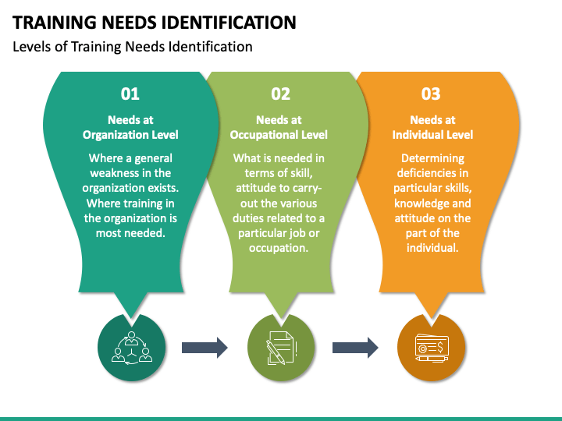

Slide 31
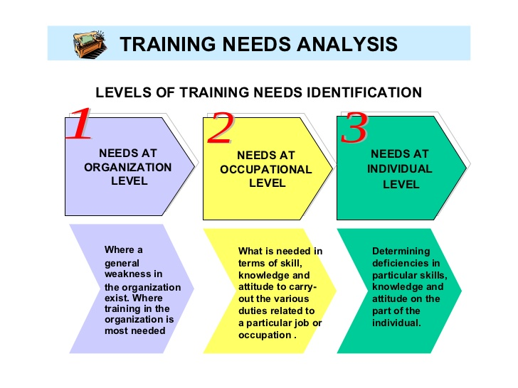

Slide 32

1) Organisational needs –
This step evaluates the overall training needs in the business.
This is where you analyse future skills needs due to changes to provide quality service provision, equipment, technology, teams or in response to economic or political factors.
Upcoming changes in law or industry standards may also influence the training needs for your business.
Practical ways of identifying organisational needs is by reviewing documents, processes, setting up advisory teams and carrying out a SWOT (strengths, weaknesses, opportunities and strengths) analysis - our SWOT analysis template will help you get started:
SWOT analysis blank template (DOC, 12K)

Slide 33
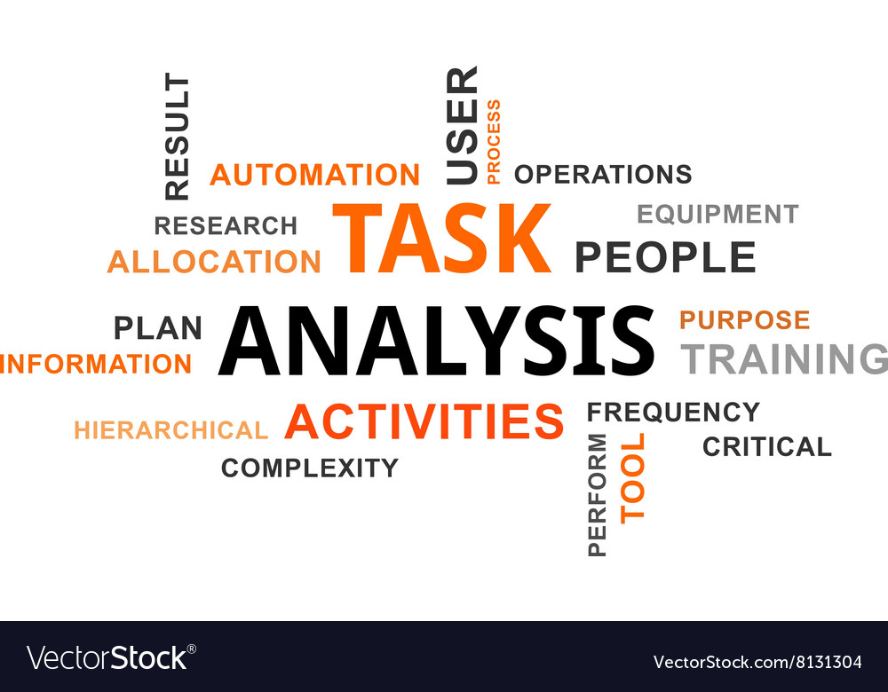
2) Task analysis –
At this level you compare the job requirements of your business with existing employee skills and knowledge.
This will help you to identify the potential gaps.
Here you establish how often specific tasks are performed, the level of skill and knowledge required to perform these tasks and where and how these skills are best acquired.
Practical ways of carrying out this analysis is to create assessment centres, tests or practical observations of employees carrying out key tasks.

Slide 34

3) Individual needs –
At this stage, you examine the training needs of each employee.
This information is most often gathered from performance reviews and appraisal systems.
You may seek feedback from employees on their recommendations on how to solve problems that may be hampering their day-to-day job.
Other practical ways of identifying individual training requirements for your employees is through surveys, questionnaires, interviews and focus groups.
SWOT analysis template with specific staff training questions (DOC, 17K)

Slide 35
https://youtu.be/JXXHqM6RzZQ
SWOT stands for strengths, weaknesses, opportunities, and threats. Strengths and weaknesses are internal factors and opportunities, and threats are external factors.
A SWOT diagram analyses a project or business venture by focusing on each of these factors. It typically consists of four boxes, one for each area, but the exact shape may vary depending on the design.

Slide 36

Collecting Data About and From Learners
Learning needs analysis data collection can be either formal, informal or a combination of both.
However, having a formal approach to data collection is important in order to support decisions regarding organisational training, budgets and data for future evaluation (ACN, 2018).
It often starts with conversations with unit managers, supervisors, members of the multidisciplinary team that work within the unit, patients and families, and of course your own staff on the floor.

Slide 37
Another way to determine educational needs of learners is to review the following:
Risk management programs that detail falls or medication errors over a period of time;
Occupational health and safety records;
Mandatory training requirements;
Staff surveys; and
Feedback from healthcare consumers.

Slide 38
Cond….
If the problem identified is not attributable to worker performance, training may not be the best solution.
For instance, a company might discover that its employees have received appropriate training to perform their jobs but are not motivated to do so.
In this situation, it would be more appropriate for the company to reconsider its system of compensation and awards.

Slide 39


Slide 40

Those who benefit from the TNA include the employees, employers and consumers.
When a TNA is done correctly it is a win-win for everyone involved because as employees gain more confidence in their ability to perform, they will do better.
For employers once the training has been conducted and accomplished they can require more from employees and gain that ROI sooner than later.
As for consumers, they are given a better quality product in a better time rate depending on the TNA that is given.
It takes the employer taking a chance and receiving the most beneficial results in the end.

Slide 41
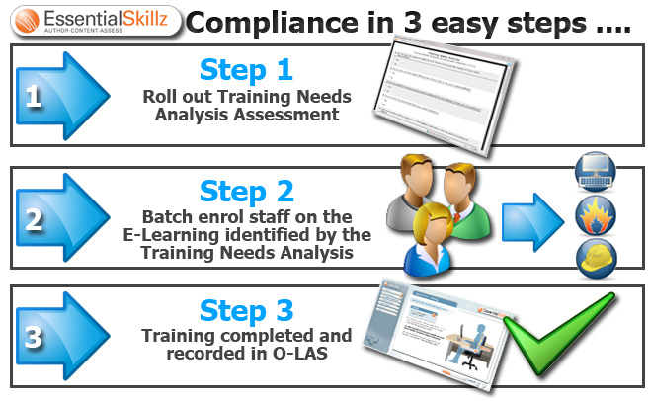

Slide 42

How is training conducted? Once the who, what, when, where and why’s are answered it is time for action as to how a TNA is performed.
Depending on the answers from the checklist an outline of the training events are put together.
Teams are given, instructors are chosen and an evaluation is performed during and after each event.
Team building, knowledge check, hands on interaction or whatever your events are geared towards should be mapped out within the outline.

Slide 43
How is training conducted?
The outline should be extremely detailed to tailored the name of event, total time of event, the number of participants for each event, where the event will be located and a small summary what each event is required to do.
The evaluation that is being performed during each training event should be consistent as well. each evaluation should have the same questions or criterias.
The evaluation should map out where this team was before training and how they are during training.

Slide 44

A secondary evaluation should be given on an agreed upon basis like quarterly, semi-annually or yearly basis.
This is to track the ROI for the company and prove to everyone if the training was memorized or internalized.
Depending on the results from each evaluation should let the company know if the TNA was purposeful or not.

Slide 45
https://talentconnections.weebly.com/blog/tna-training-needs-analysis
https://hr.wisc.edu/professional-development/develop-your-career/employee-development/career-goals/
https://www.ausmed.co.uk/cpd/articles/how-to-conduct-a-training-needs-assessment

